Slide 1
Service Learning Practicum:
Women’s Initiative Client Scheduling System
(Technical Topic)
Ethical and Moral Responsibility of
Information Privacy in Business
(STS Topic)
Alex Weaver
STS 4500

Slide 2
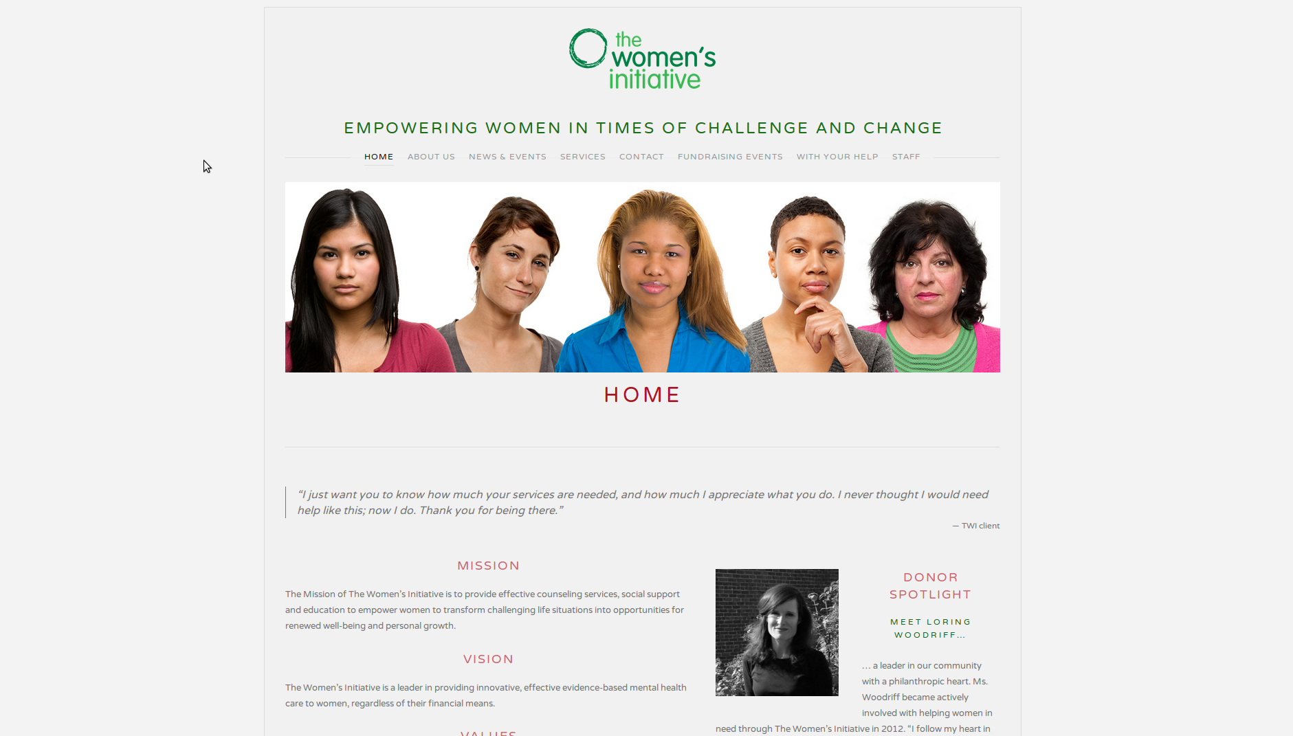
The Women’s Initiative

Slide 3
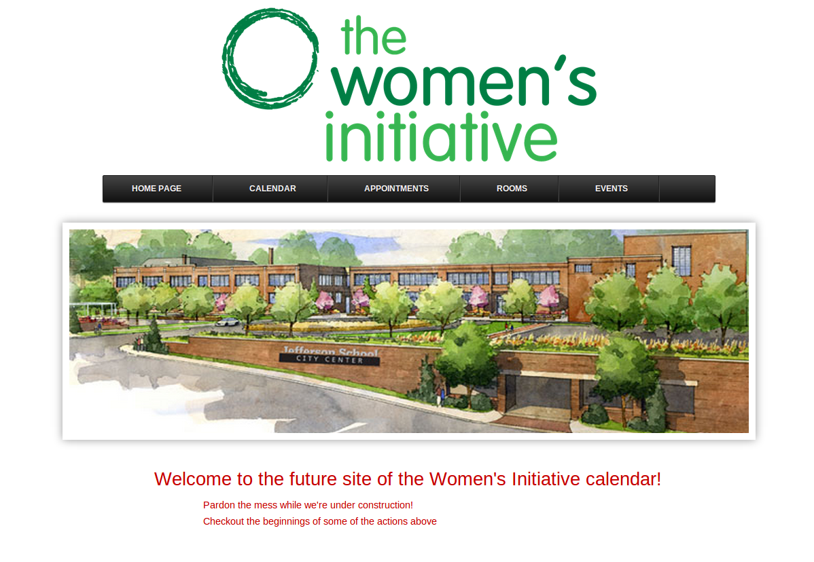
Our Site

Slide 4
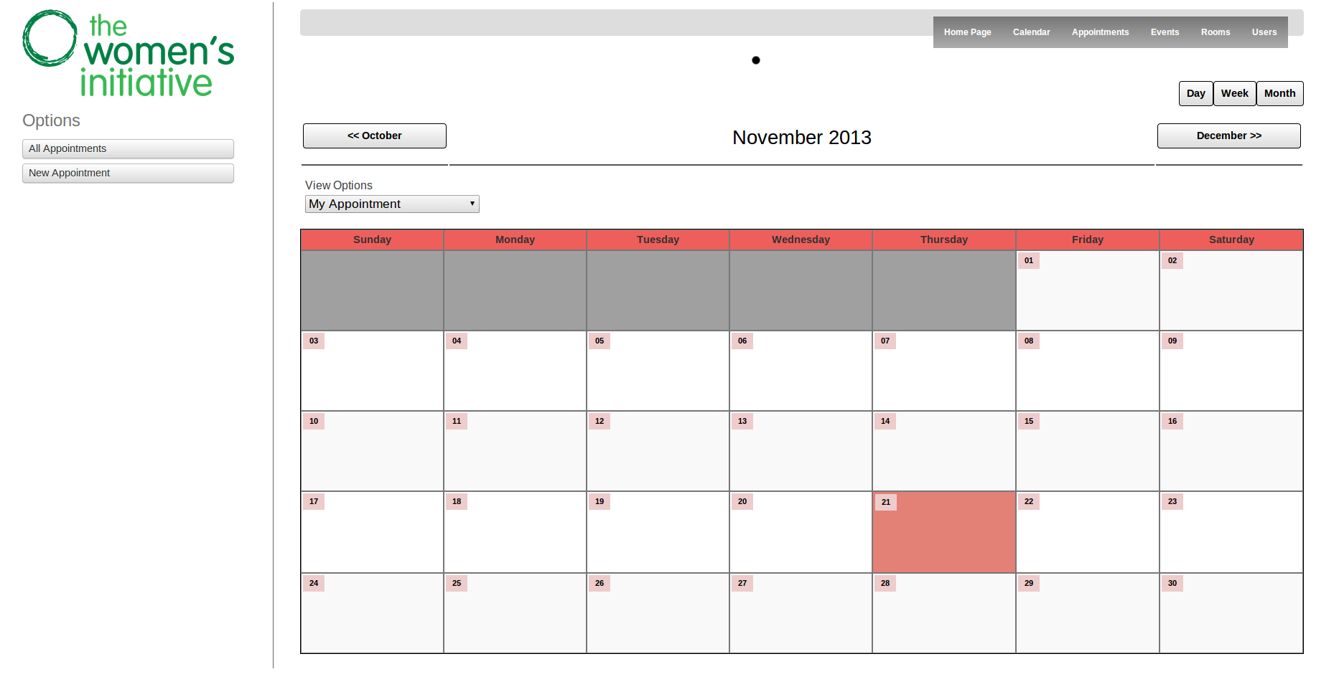
The Scheduling System

Slide 5
Information Privacy
“Categorized by the desire of individuals to have a degree of control over data about themselves”

Slide 6
Moral Responsibility
The Responsibility of Companies
Emphasis on IT and Healthcare
The Responsibility of the Consumer

Slide 7
References
Belanger, F., Crossler, R. E. (2011). Privacy in the digital age: a review of information privacy research in information systems. MIS Quarterly.
CakePHP. (2013). CakePHP Cookbook Documentation: Release 2.x.
Cushman, R. (1996). Information and Medical Ethics: Protecting Patient Privacy. IEEE Technology and Society Magazine.
Culnan, M. J., Williams, C. C. (2009). How Ethics Can Enhance Organizational Privacy: Lessons from the ChoicePoint and TJX Data Breaches. MIS Quarterly.
Dubois, J. (2013). Security and Performance Tuning of a REST and Ajax Application. Oracle.
Hsu, M. H., Kuo, F. Y. (2003). The Effect of Organization-Based Self-Esteem and Deindividuation in Protecting Personal Information Privacy. Journal of Business Ethics.
Kosmajac, D., Elektroteh, Fak. (2012). Information Systems security and security extension in Jersey RESTful framework. Telecommunications Forum.
Shore, J., Warden, S. (2007). The Art of Agile Development.
Stahl, B. C. (2004). Responsibility for Information Assurance and Privacy: A Problem of Individual Ethics? Journal of Organizational and End User Computing.
Symantec Corporation (2012). Internet Security Threat Report Volume 17.
Wang, F., Yan, L., Hui, L. (2012). The research of RESTful web services applied in Chinese medicine information system based on Restlet framework. Communications in Computer
and Information Science.
Women’s Initiative, The (2013). About Us. thewomensinitiative.org.

